Slide 1
Digital product design
Lecture 7: Choosing Metrics
Alex Moehring

Slide 2
Outline
Probability in 1 Slide
Organizational metrics
Combining Metrics
Targeting for Long Term Outcomes
Engagement as a Metric

Slide 3
Probability in 1 slide

Slide 4
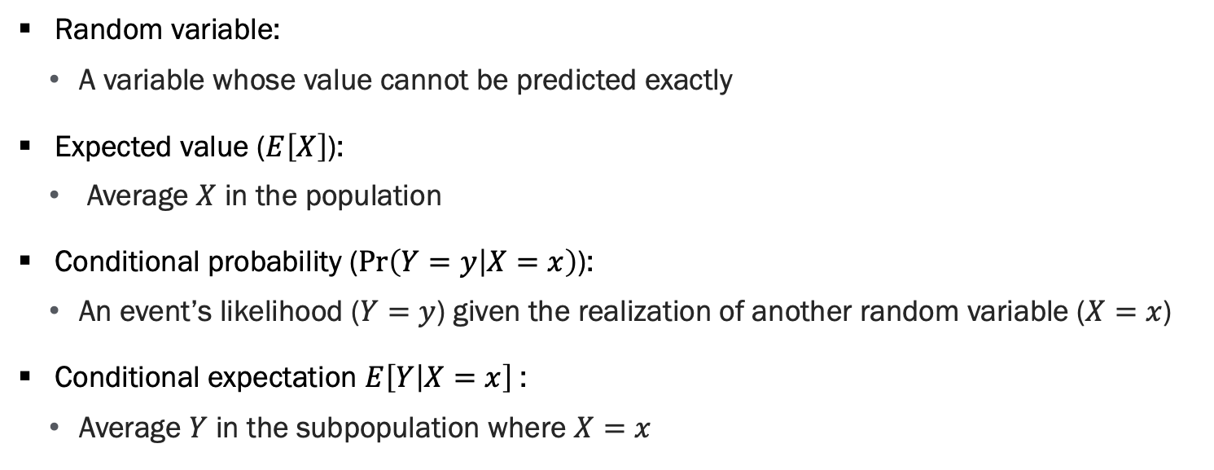
Probability Review
Random variable:
A variable whose value cannot be predicted exactly
Expected value ($E\left[X\right]$):
Average $X$ in the population
Conditional probability ($\operatorname{Pr}\left(Y=y | X=x\right)$):
An event’s likelihood ($Y=y$) given the realization of another random variable ($X=x$)
Conditional expectation $E\left[Y | X=x\right]$:
Average $Y$ in the subpopulation where $X=x$

Slide 5
Organizational metrics Kohavi, Tang, and Xu (2020)

Slide 6
What Are Metrics?
Metrics are what you measure
Good metrics proxy the long-term objective of the organization

Slide 7
Types of Metrics
Goal metrics: Reflect what organization ultimately cares about
Driver metrics: Short-term and more sensitive than goal metrics
Aka sign post metrics, surrogates, indirect
Reflect a causal model of what moves the goal metrics
Guardrail metrics: Verify assumptions and protect organization
Examples include user-experience (page load) or trust / safety stats

Slide 8
Goal Metrics
Goal metrics: Reflect what organization ultimately cares about
Directly related to organization’s mission
Often hard to measure in the short-run
Helpful to articulate organization’s mission in words and then proxy this goal with metrics
Proxy is often imperfect, constantly refine
Important to understand metrics are a proxy for this goal

Slide 9
Driver Metrics
Driver metrics: Short-term and more sensitive than goal metrics
Aka sign post metrics, surrogates, indirect
Reflect a causal model of what moves the goal metrics
Often includes “up-the-funnel” metrics

Slide 10
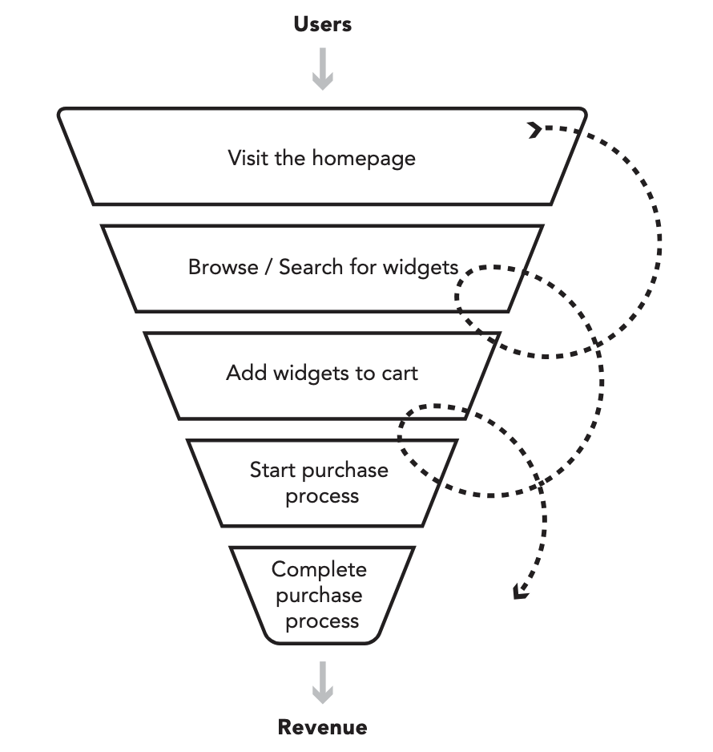
Driver Metrics, Part 2
Source: Kohavi, Tang, and Xu (2020)

Slide 11
Driver Metrics, Part 3
Different teams may have different driver metrics
Example: Content business adopting the advertising revenue model wants to maximize long-term profits.
What is a good driver metric for the content team?
What is a good driver metric for the support team?

Slide 12
Guardrail Metrics
Guardrail metrics: Verify assumptions and protect organization
User-experience (page load time)
Trust / safety stats
Security often in conflict with ease of use

Slide 13
Additional Metrics
Useful to collect a suite of metrics related to key metrics
E.g. If CTR is a key metric, we might want to track where clicks happen on the page to understand what is moving the CTR
Question: If revenue is a key metric, what other metrics might we want to track?
Extensive / intensive margin, category of sales, referral source

Slide 14
Challenges of Metrics
Goal metrics:
Long-run and hard to move
Driver metrics:
Potentially distracting
Difficult to find good driver metrics
Potentially gameable
Guardrail metrics:
Easy to look past
Notes:
Gameability examples:
- Bonuses paid to operations managers based on maintaining low inventory, resulted in parts shortage and shipping delays

Slide 15
Defining Metrics
Measure relationships between data you collect and goal metrics
Example: One of Netflix’s goal metrics is the retention rate of existing customers. This is a slow-moving target, what are possible driver metrics?
Streaming hours is correlated with retention
Relationship is non-linear
Most important to move light users to moderate users than heavy users to heavier users (Xie and Aurisset, 2016)

Slide 16
Defining Metrics, Continued
Measure relationships between data you collect and goal metrics
Example: Facebook has a goal of showing content users like. How can we find driver metrics for this goal?
Rank content by predicted engagement
Assumption is that people engage with what they like
Survey users: “Is this post worth your time?” (Gupta, 2021)
Is this scalable?
One way to scale: survey a subset of users and predict survey responses

Slide 17
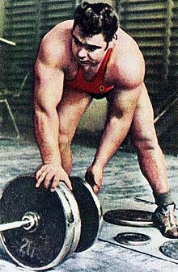
Gameability of Metrics – Vasily Alekseyev
Soviet government paid a bonus every time he broke a WR
What do you think happened?
He broke his own record ~80 times increasing WR by 1lb each time
Source: Spitzer (2007), Kohavi, Tang, and Xu, (2020)

Slide 18
Gameability of Metrics – The Chicken KPI
Fried chicken chain evaluated managers based on the Chicken Efficiency Index (Chicken Sold / Chicken Cooked)
“Oh yeah we get tons of kids coming in here after baseball or soccer practices or games, families, and lots of people. I tell them I’m going to make their chicken to order and it will take 15-20 minutes.”
“they file right out the door and head off someplace else, but management doesn’t measure that.”
Source: Spitzer (2007), Brown (2019), Kohavi, Tang, and Xu, (2020)

Slide 19
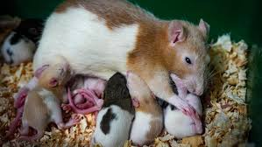
Gameability of Metrics – Hanoi Rat Bounty
There was a program in Hanoi paying a bounty for every rat tail handed in to control the rat population
Led to the growth of a small industry of breeding and raising rats
Source: Wikipedia contributors, Kohavi, Tang, and Xu, (2020)
Source: ABC

Slide 20
Takeaways
Finding good metrics is hard
Start with the organization’s mission, proxy this with goal metrics
Proxy goal metrics with short-term driver metrics
Set up effective guardrail metrics to protect the business
Avoid gameable metrics
“Tell me how you measure me, and I will tell you how I will behave”
- Goldratt (1990)
“Show me the incentives, and I’ll show you the outcome”
- Charlie Munger (1995)

Slide 21
Overall evaluation criteria Kohavi, Tang, and Xu (2020)

Slide 22
Metrics Useful for Decisions
Data-driven organizations have goal, driver, and guardrail metrics to achieve their goals and align their efforts
These are not always useful for decision making
Metrics useful in decision making must be
Measurable in a scalable way
Sensitive & timely
Stock price is insensitive to most decisions
Feature availability is sensitive
Notes:
Gameability examples:
- Bonuses paid to operations managers based on maintaining low inventory, resulted in parts shortage and shipping delays

Slide 23
Metrics Useful for Decisions - Examples
User experience: Hard to measure user happiness
Proxy with behavioral data
Ad-revenue: Common for outliers with high CPC to affect revenue
CTR or truncated revenue could be more sensitive
Subscription: Metric moves with the renewal cycle
Perhaps shorter-term surrogates are more sensitive
Notes:
Gameability examples:
- Bonuses paid to operations managers based on maintaining low inventory, resulted in parts shortage and shipping delays

Slide 24
Combining Key Metrics into an OEC
Organization has many metrics they care about
There is often a mental model of tradeoffs among these metrics
What drop in active users is acceptable for an increase rev per user?
Combining these metrics into an OEC (Overall Evaluation Criteria) allows you to codify tradeoffs and quantitatively define the objective
Often (but not necessarily) a weighted average of metrics
Aligns people in the org about tradeoff and what constitutes success
Results in more consistent decisions
Notes:
Gameability examples:
- Bonuses paid to operations managers based on maintaining low inventory, resulted in parts shortage and shipping delays

Slide 25
Deciding on the OEC
This is very context dependent
Should proxy the highest goal metrics
This can (should) change over time
If the decision that maximizes the expected OEC seems wrong, revisit the OEC. What is missing?
Notes:
Gameability examples:
- Bonuses paid to operations managers based on maintaining low inventory, resulted in parts shortage and shipping delays

Slide 26
OEC Case Study – Amazon Emails
Amazon evaluating a program to send emails to customers recommending new books
Initial OEC was short-term revenue
More emails => Weakly more short-term revenue
Complaints started to come in about spam emails
Annoyed users unsubscribe, lose potential for future emails
Notes:
Gameability examples:
- Bonuses paid to operations managers based on maintaining low inventory, resulted in parts shortage and shipping delays

Slide 27
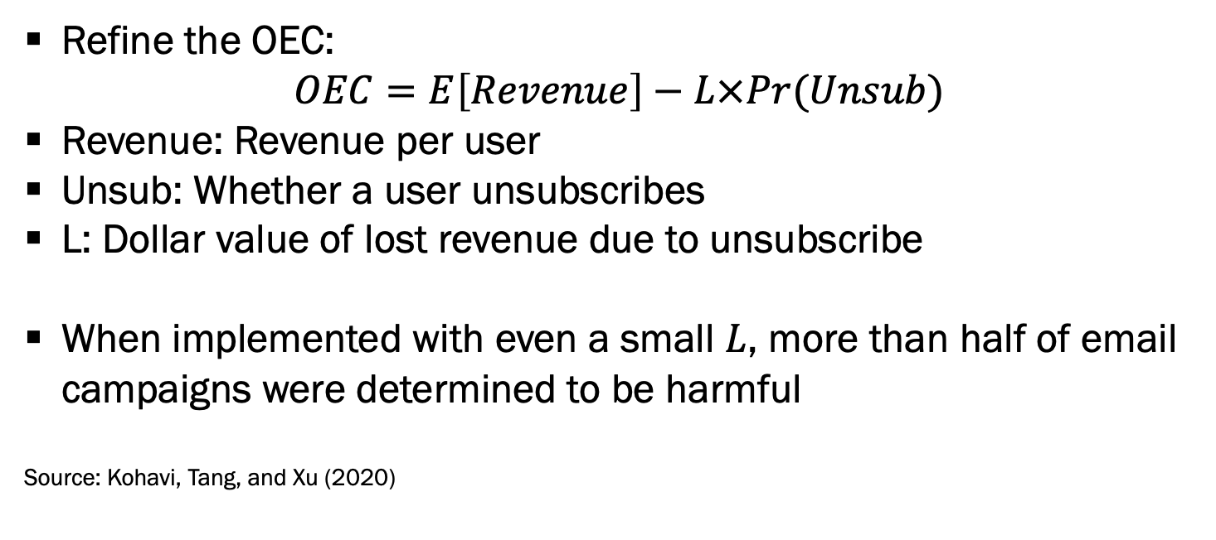
OEC Case Study – Amazon Emails, Continued
Refine the OEC:
$$OEC=E\left[Revenue\right]−L×Pr(Unsub)$$
Revenue: Revenue per user
Unsub: Whether a user unsubscribes
L: Dollar value of lost revenue due to unsubscribe
When implemented with even a small $L$, more than half of email campaigns were determined to be harmful
Source: Kohavi, Tang, and Xu (2020)
Notes:
Gameability examples:
- Bonuses paid to operations managers based on maintaining low inventory, resulted in parts shortage and shipping delays

Slide 28
OEC Case Study – Bing Search
Bing introduced a bug that led to bad organic search results
Two metrics shot up: queries per user and revenue per user
Why?
Bing had to revise their OEC to include driver metrics that better proxy their goal metrics
Sessions per user became more important, as satisfied users are likely to return
Source: Kohavi, Tang, and Xu (2020)
Notes:
Gameability examples:
- Bonuses paid to operations managers based on maintaining low inventory, resulted in parts shortage and shipping delays

Slide 29
Boston globe Yang, Eckles, Dhillon, and Aral (2023)

Slide 30
Boston Globe
Newspapers increasingly turning to subscriptions for primary revenue source
Goal metric of long-term customer value (retention of existing customers)
Deciding how to target marketing interventions
Price discounts in this setting
Key problem: Long-term customer value is realized in long-term!
Solution 1: Try a policy, wait, update actions once you observe the outcome
Solution 2: Proxy goal metric with short-term driver metric and iterate faster

Slide 31
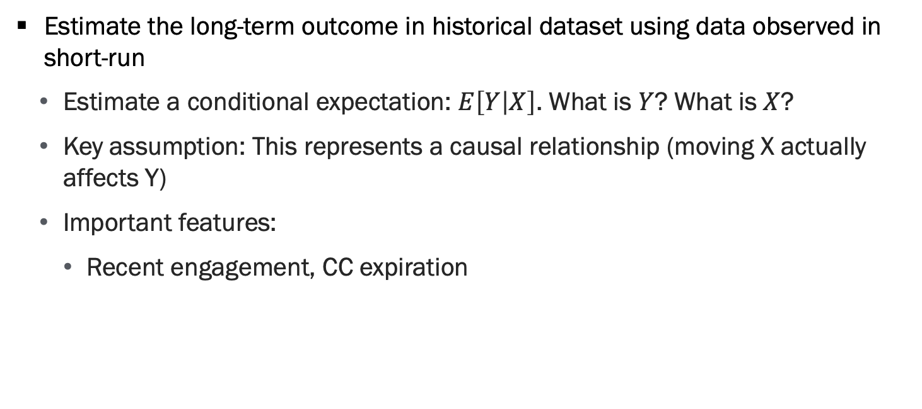
Methodology
Estimate the long-term outcome in historical dataset using data observed in short-run
Estimate a conditional expectation: $E\left[Y | X\right]$. What is $Y$? What is $X$?
Key assumption: This represents a causal relationship (moving X actually affects Y)
Important features:
Recent engagement, CC expiration

Slide 32


Methodology, Continued
Choose discount for each consumer to maximize predicted retention: $E\left[Y | X\right]$
I.e. the discount that maximizes expected long-term revenue

Slide 33
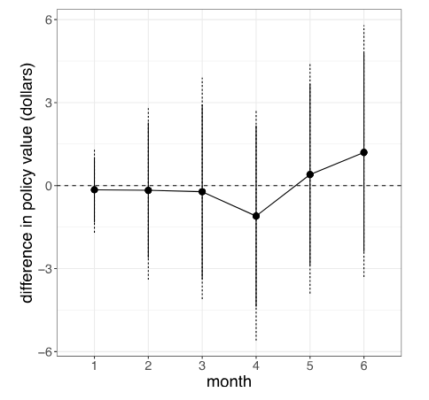
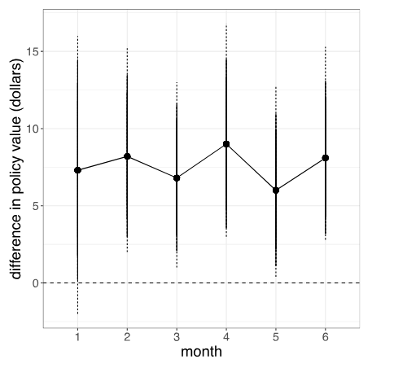
Results
Policy Targeting Short-Term Revenue
Policy Targeting Expected Long-Term Revenue
Optimizing for LT proxies increased revenue by ~$5 million

Slide 34
Recap
Targeting the right metrics are important
Can have real impact on bottom line
Pick driver metrics carefully
They should be on the causal path to ultimate goal metrics
Use data to find right driver metrics & combine into an OEC
Question: What is the OEC in this case?
We can then use driver metrics / OEC to guide decisions more effectively

Slide 35
Engagement as a metric

Slide 36
Why Engagement as a Metric
Engagement often defined as clicks, likes, time spent, comments …
Many digital products measure success through engagement
In part due to the dominance of advertising revenue model
Engagement signals are easy to collect and highly sensitive

Slide 37
Why Engagement as a Metric, Continued
Engagement is related to customer value
Customers engage with things they like to engage with!
However, focus only on engagement can cause issues

Slide 38
Concerns with Optimizing for Engagement
Could the user get the same value faster?
Does adding interstitial pages increase time? User value?
Does this incentivize temptation goods?
I eat more Cheetos than I’d like, I watch more YouTube than I like
Many human biases exist where our actions differ from our “true” preferences
How deliberative are you when you are scrolling through social media?
Unconscious bias when we don’t deliberate
Have you ever tried to “train” your social media algorithm?

Slide 39
Concerns with Optimizing for Engagement, Continued
“One of the biggest issues social networks face is that, when left unchecked, people will engage disproportionately with more sensationalist and provocative content. ... People consistently tell us these types of content make our services worse -- even though they engage with them.”
— Mark Zuckerberg, 2018

Slide 40
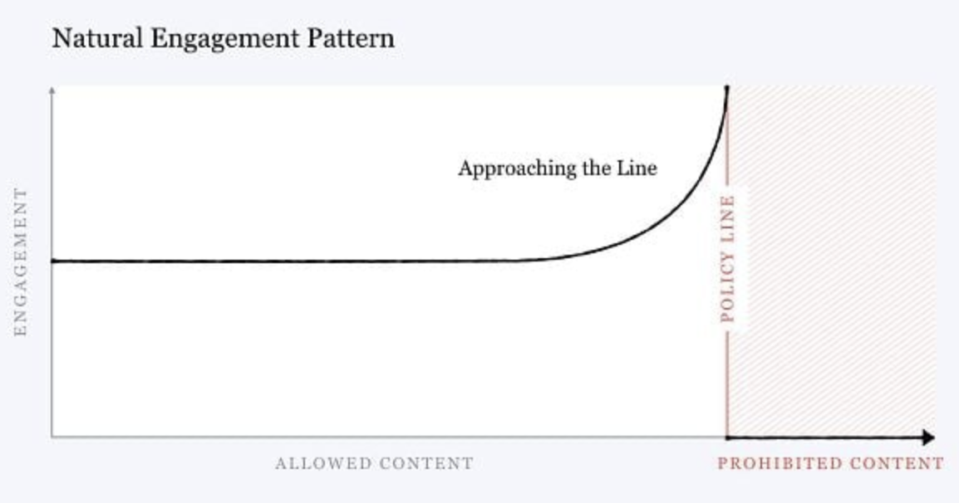
Additional Concerns – Externalities Among Users
Are there externalities among users?
Certain types of content may be highly engaging to some users, but drive others away
Source: Zuckerberg (2018)

Slide 41
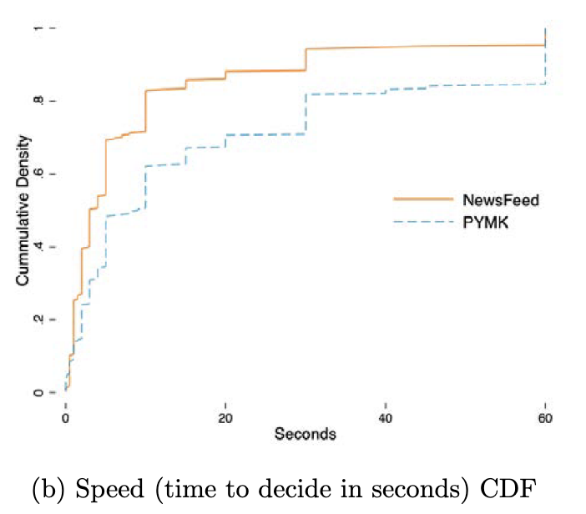
Exacerbating Biases
Study comparing FB people you may know algorithm (PYMK) and the news feed
PYMK engagement decisions take much longer than news feed decisions
Evidence of out-group bias on news feed (e.g. White people less likely to see posts from Black friends) but not on PYMK
Source: Agan, Davenport, Ludwig & Mullainathan (2023)

Slide 42
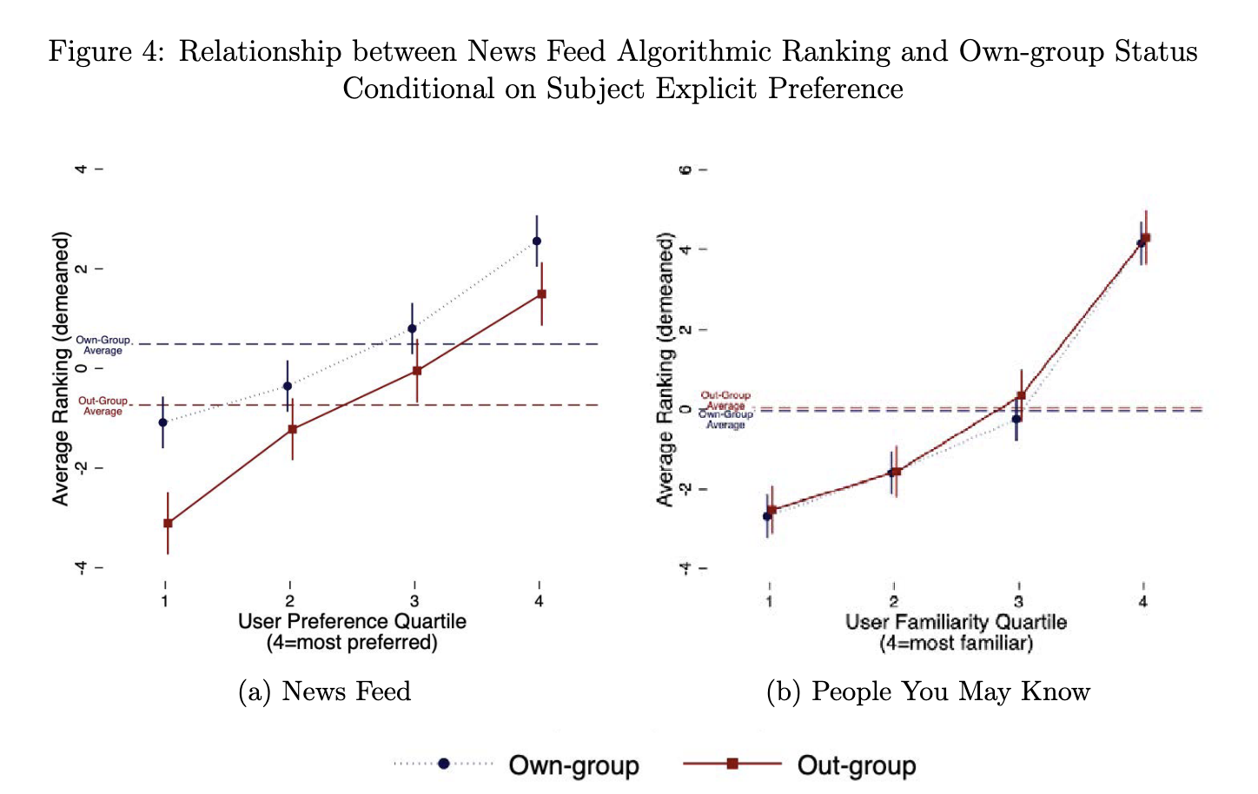
Exacerbating Biases, Continued
Study comparing FB people you may know algorithm (PYMK) and the news feed
PYMK engagement decisions take much longer than news feed decisions
Evidence of out-group bias on news feed (e.g. White people less likely to see posts from Black friends) but not on PYMK
Source: Agan, Davenport, Ludwig & Mullainathan (2023)

Slide 43
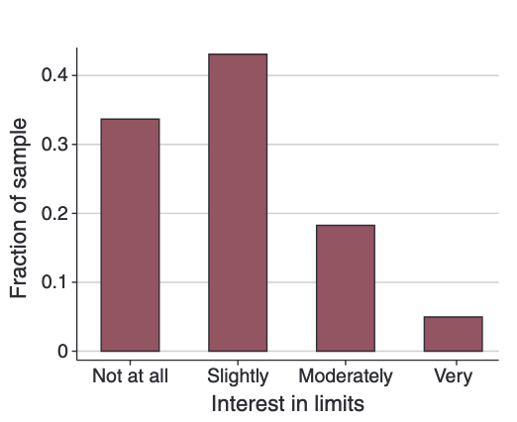
Additional Concerns – Short vs Long Term Engagement
Many people express an interest in technology that limits their access to engagement-based services
This does not happen with standard goods
Many people take breaks from social media, requires uninstalling the app / deleting you account
Source: Allcott, Gentzkow, and Song

Slide 44
Summary

Slide 45
Engagement as a Metric Recap
Goal metrics proxy the mission
Driver metrics proxy the goal
Guardrail metrics protect the organization
Overall Evaluation Criteria encodes tradeoffs between metrics into an objective function
Careful selection of driver metrics has big payoffs (e.g. Boston Globe)
Engagement often a useful metric

